Slide 1
Grandmother
Aunts older
than mother
Mother
Aunts younger
than mother
Cousins
Older sisters
Ego
Younger sisters
Cousins
Nieces through
younger sister
Daughter
Nieces through
younger sister

Slide 2
1.2
Grand-
mother
1.3
0.6
1.5
Older
aunts
Mother
Younger
aunts
3.1
0.2
1
0.5
2.8
Cousins
Older sisters
Ego
Younger sisters
Cousins
0.1
0.3
0.1
Nieces
Daughter
Nieces

Slide 3
0.8
Grand-
mother
0.8
0.4
1.2
Older
aunts
Mother
Younger
aunts
2.8
0.1
1
0.5
2.3
Cousins
Older sisters
Ego
Younger sisters
Cousins
0.1
0.3
0.1
Nieces
Daughter
Nieces

Slide 4
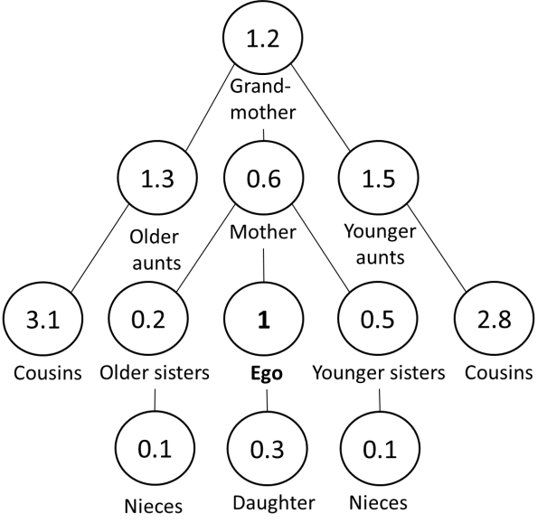
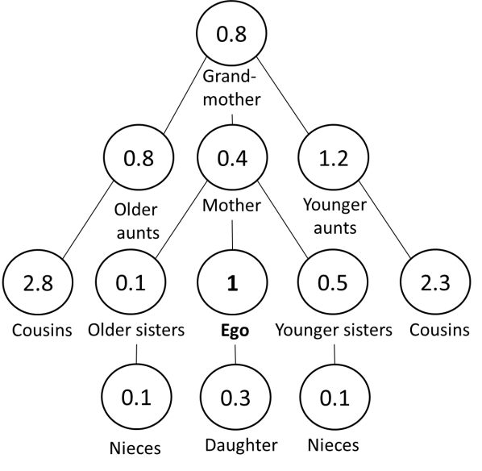
Covid-19 excess mortality
Counterfactual (non-Covid-19)
With Covid-19 excess mortality

